Slide 1
New Aviation Low Risk Aircraft Purchase Project
Identify Low Risk Aircraft for Commercial and Private Enterprise
Aviation Safety and Risk Analysis
2025
This project focuses on reducing operational and safety risk when purchasing aircraft inorder to make a calculated decision when purchasing an aircraft, by learning from decades of aviation accident history.
Prepared by Brian.M.Chairo

Slide 2
Project Objectives
  Identify aircrafts models with :
    Low accident frequency
    Low injury severity
    Consistent operational safety in different types of flights
  Support low risk purchase of aircrafts
  Provide interactive dashboards for case study analysis
  I focus on patterns over time rather than isolated incidents, to identify the best aircraft models to be bought.

Slide 3
New Aviation Division: Leveraging Aviation Accident Analysis for a Safe and Successful Purchase and Operations of Commercial and Private Air Fleet.
Purchasing Aircrafts involves high starting capital and safety risk
Poor uninformed aircraft choices may lead to:
  Financial loss
  Non-compliance with prevailing national laws for aircraft registration and operation
  Reputational loss
  Difficulty in financing and insurance
  Unexpected operating costs.
The New Aviation Division require evidence based guidance not assumptions., to be able to minimize risk when purchasing new aircrafts.

Slide 4
AviationData_csv
Contents of the AviationData used:
Civil aviation accident records
Between 1962-2023 and 1948
Coverage:
  U.S.A AND International waters
  Commercial and private aircraft
Each record represents one reported aviation accident
This dataset allows me to evaluate long term safety trends across aircraft models.

Slide 5
Data Manipulation(preparation)
How the data was prepared:
Remove incomplete or irrelevant fields
Standardized column names
Converted date for trend analysis
Created safety indicators:
  Accident frequency per year
  Fatality rate
  Severity rate
The safety indicators ensures results are reliable and comparable across aircraft models.

Slide 6
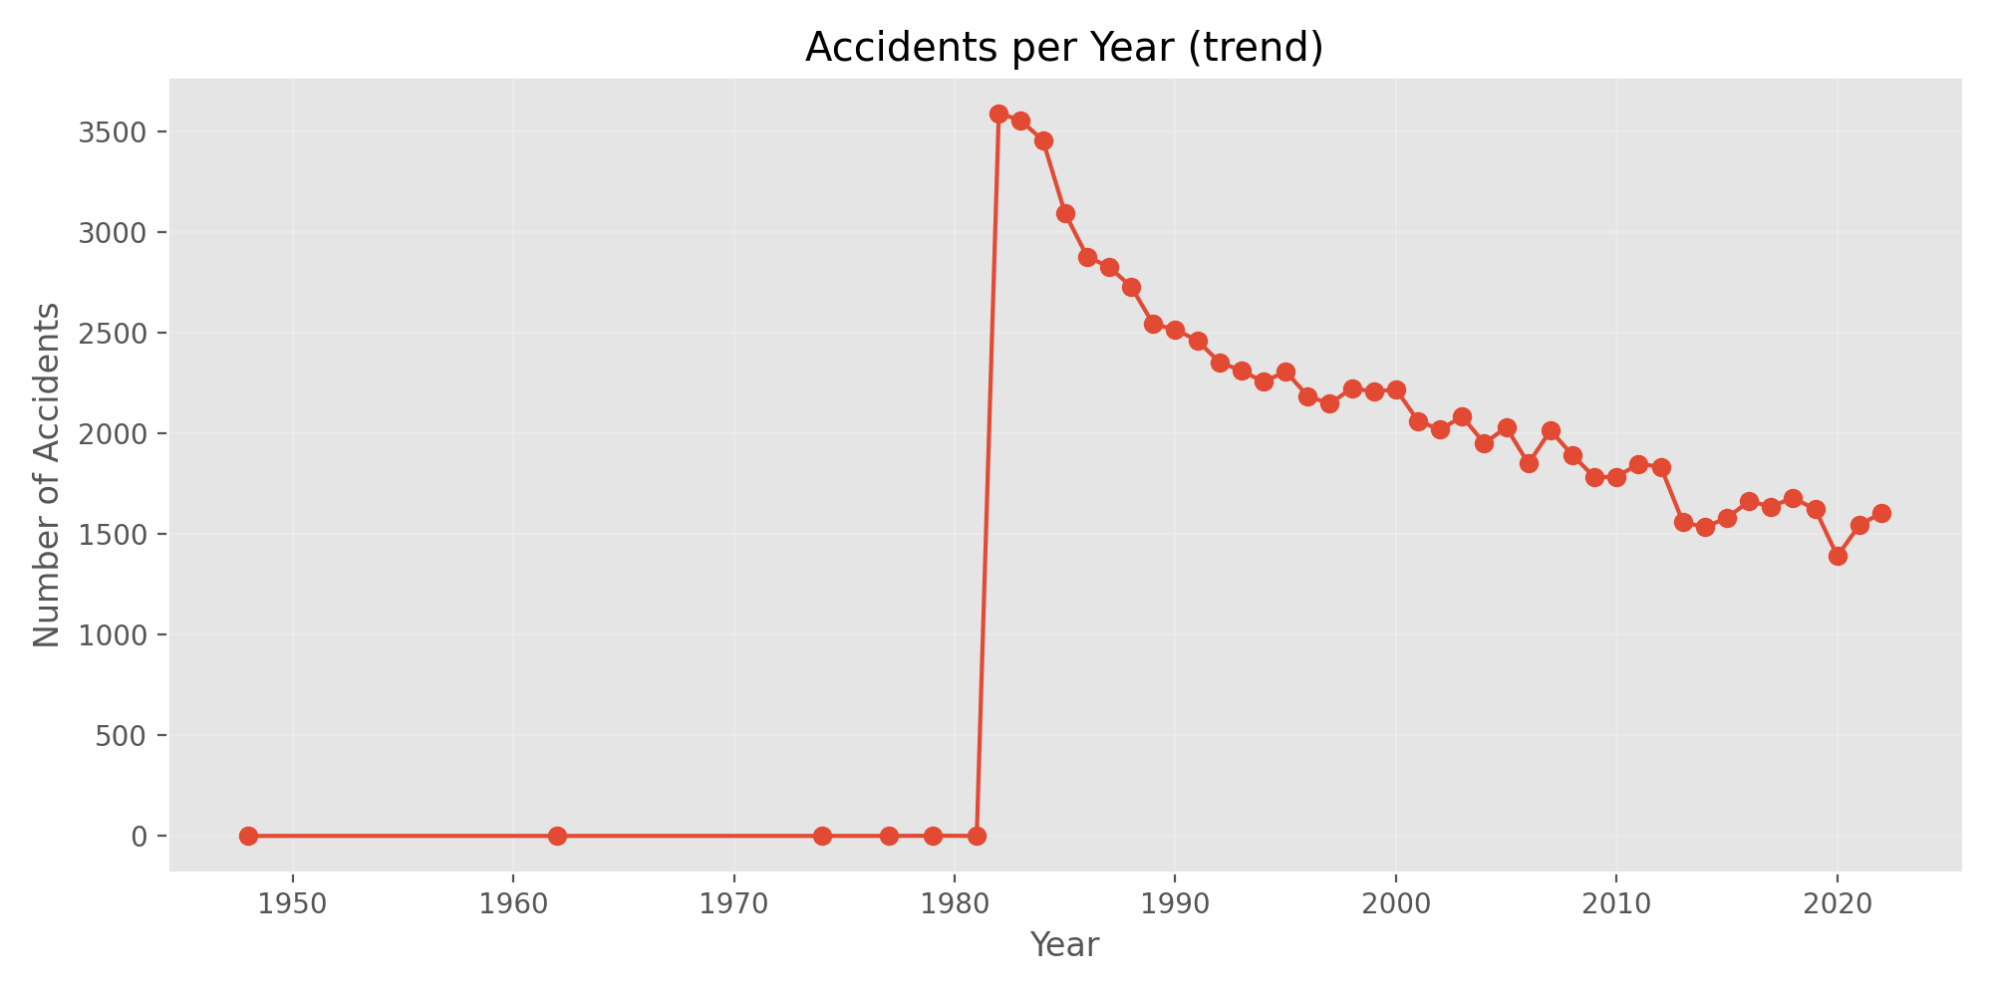
Accidents Trends Over Time
Key Observations: Accident Trends
Accident reporting increased significantly after 1980
Overall trends shows:
  Improved safety standards
  Better reporting practices
Modern aviation operates under strictier safety controls
Here I have interpreted the historical risk

Slide 7
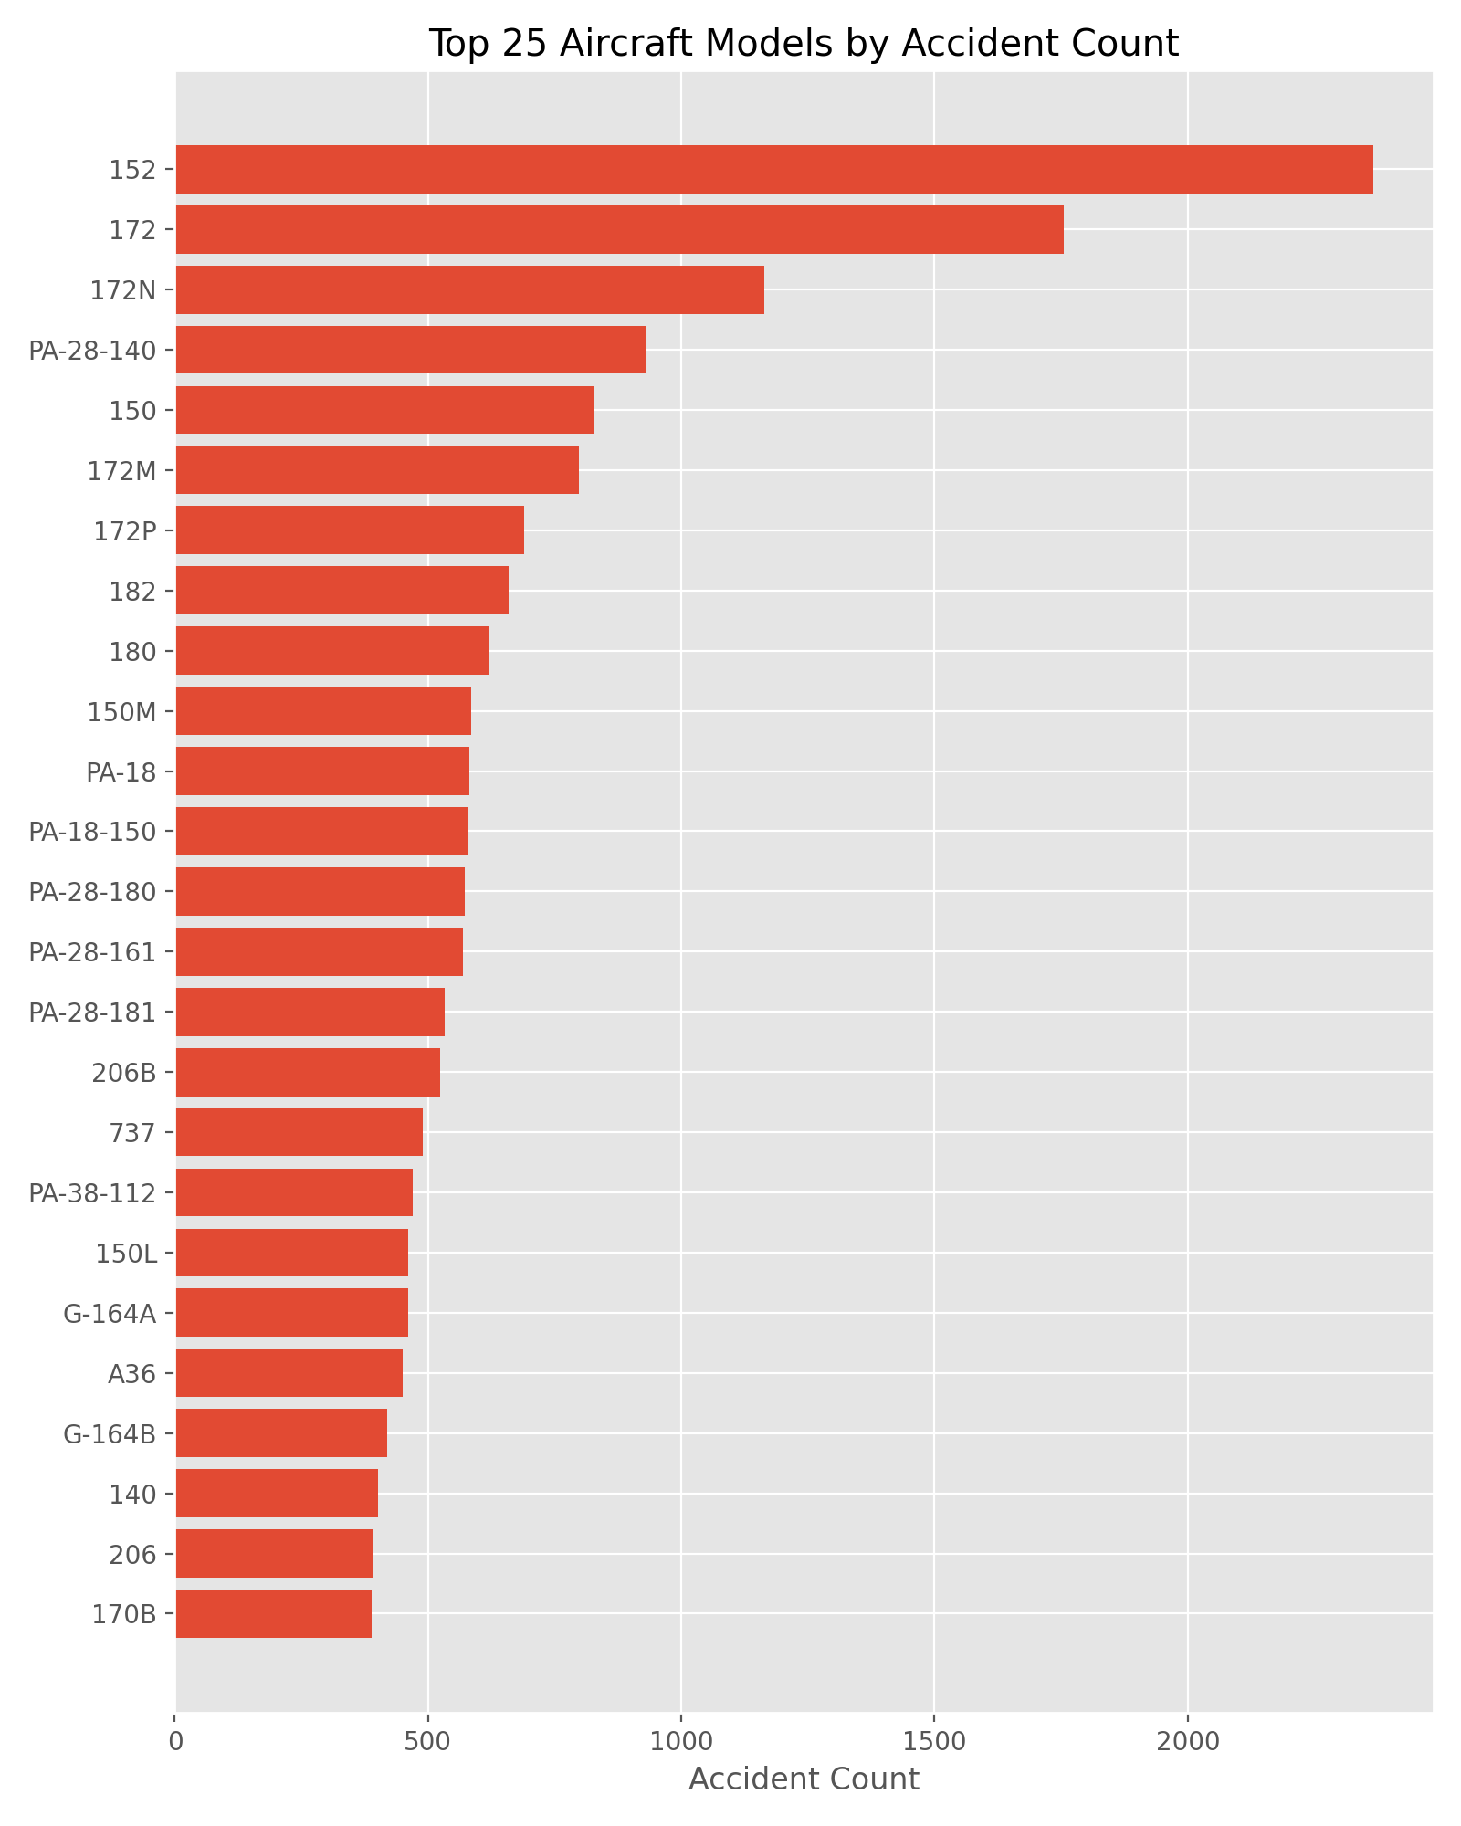
Accident Frequency by Aircraft Model
What I Observed:
Some aircraft models appear more frequently in
Higher frequency often reflects:
  Greater usage
  Longer operational history
High frequency alone does not imply high risk
The fact that some aircrafts are used more often than other models makes it important to analyse severity of accidents to make informed decision on the risk.

Slide 8
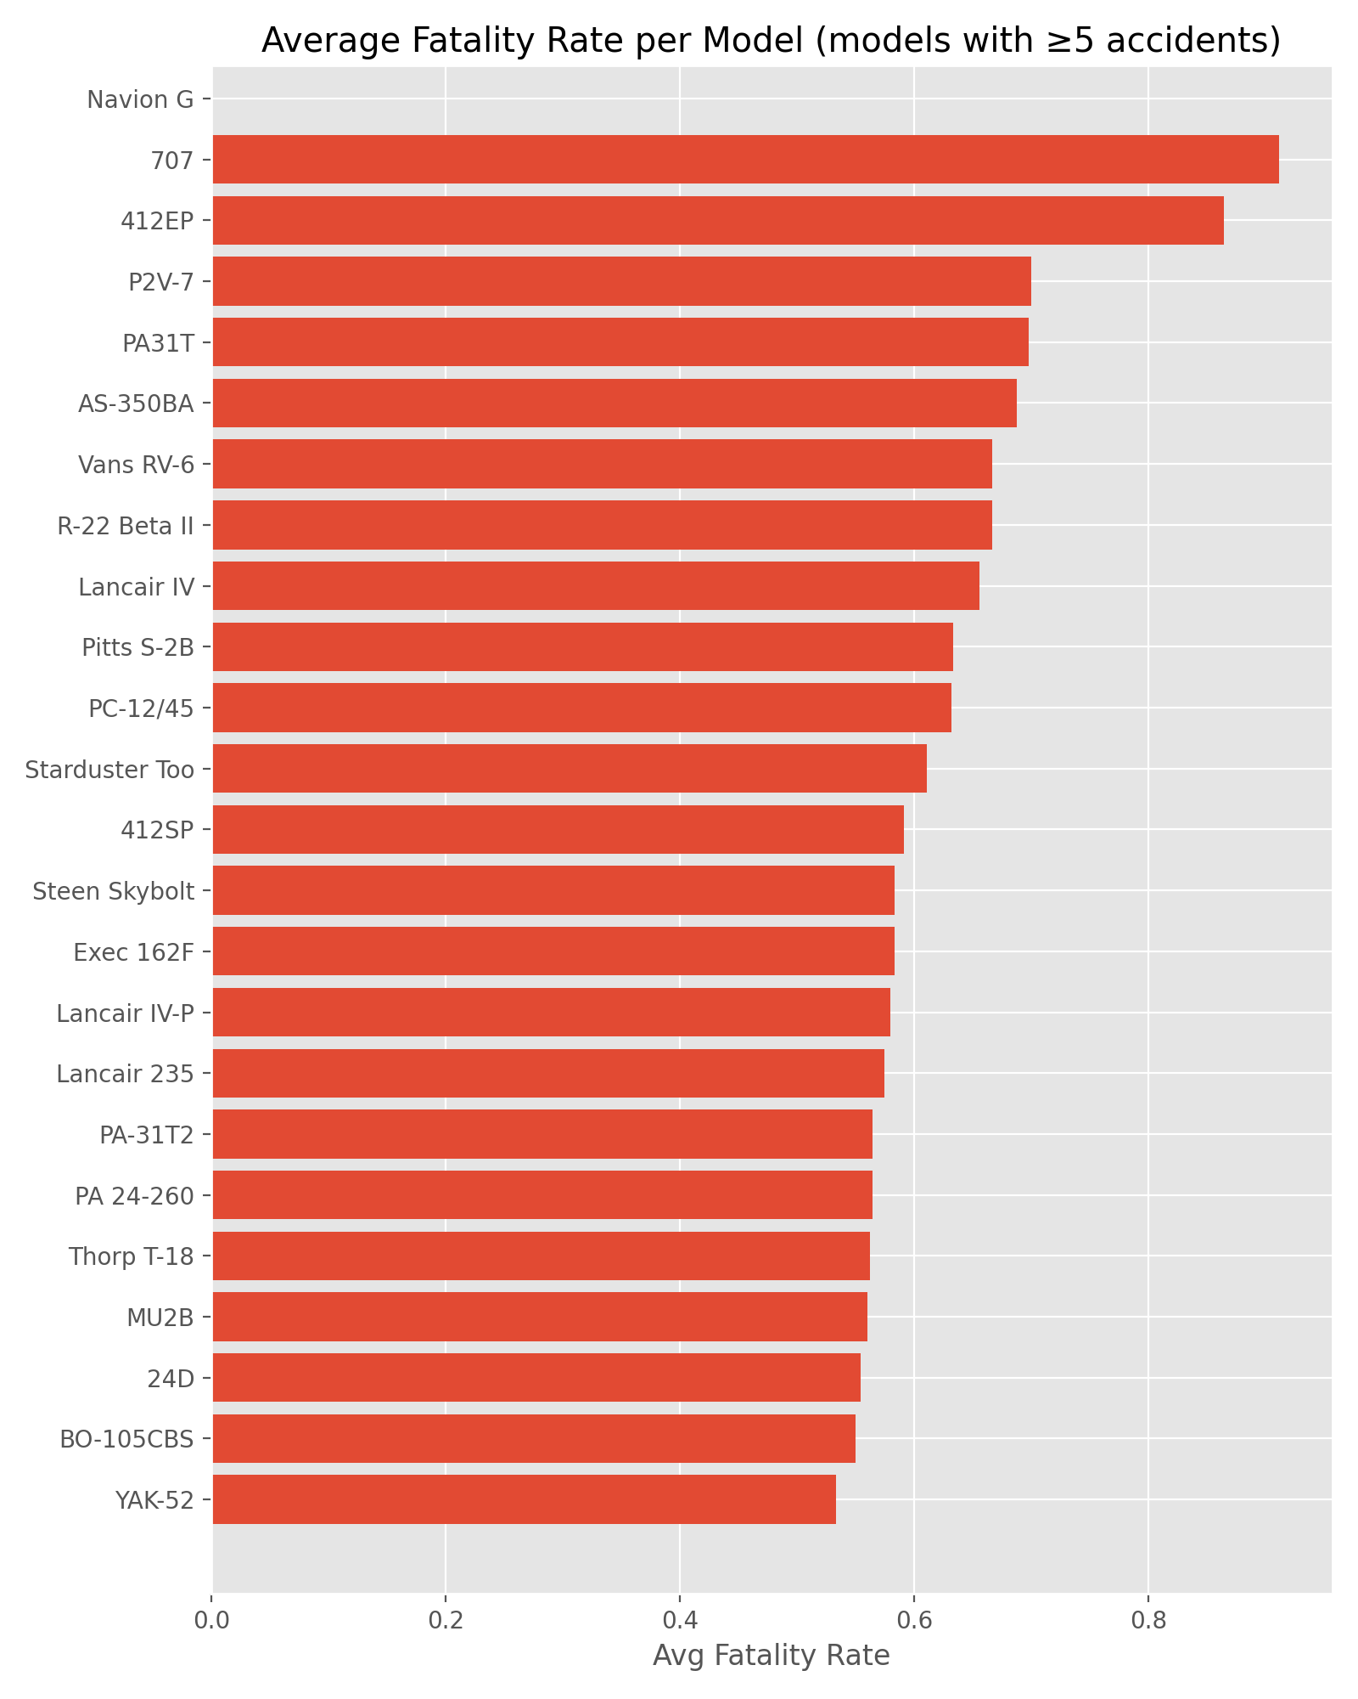
Injury Severity Matters More than Frequency of Accidents
Why Severity was prioritized
Not all accident result in serious harm
I evaluated:
  Fatal injuries
  Serious injuries
  Minor injuries
Developed a severity score to compare impact
Low risk aircrafts are those with lower injury outcomes when the accidents occured

Slide 9
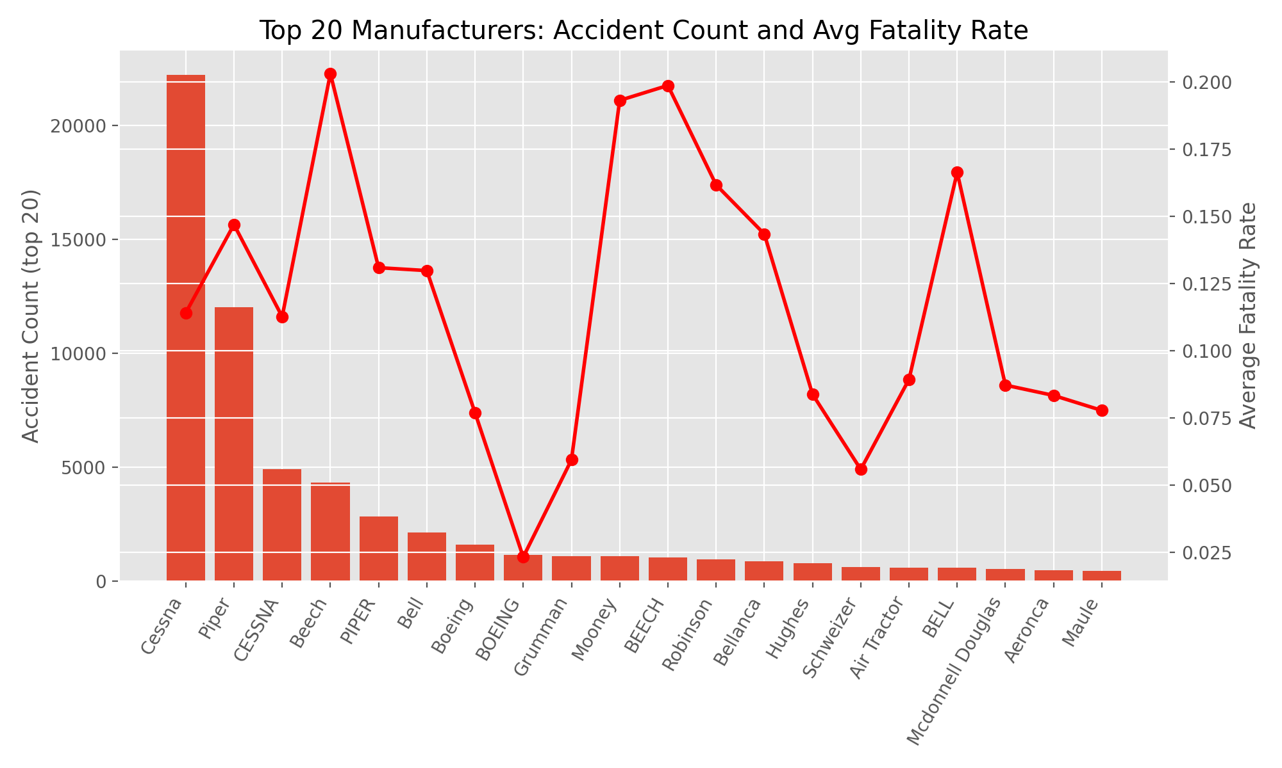
Low Risk Aircrafts Models
Low Risk Aircraft Models Identified
Selected models show:
  Multiple recorded accidents
  Zero to Near zero fatalities
  Consistently low severity scores
These models demonstrate strong safety performance
The displayed models show safer investment options based on historical evidence.

Slide 10
Interactive Dashboard for the New Aviation Division
To support deeper exploration of the findiings, an interactive dashboard has been developed in Tableau.
This dashboard will allow the New Aviation Division to:
Explore accidents trend over time
Compare aircraft models by risk and severity
Filter results by aircraft type and operational factors
Access the live dashboard here:
https://public.tableau.com/app/profile/brian.chairo/viz/New-Aviation-LowRisk-AircraftPurchase-Project-InteractiveDashboard/LowRiskAircraftDashboard

Slide 11
What this means to the New Aviation Division
Data supports:
  Reduced operational risk
  Better capital allocation
  Informed aircraft acquisition
Transforms purchasing decisions from intuition to insight
This approach aligns safely with financial sustainability.

Slide 12
Limitations & Considerations
Important Considerations
Accident data does not include:
  Total flight hours per model
  Maintainance records
Result should compliment
  Manufacturers guidance
  Regulatory assesments
  Operational requirements
This analysis informs decisions it however does not replace due diligence

Slide 13
Recommendations
Strategic:
Prioritize aircraft with:
  Low injury severity
  Stable historical performance
Avoid decision based on anecdotal safety perception
Integrate severity based metrics into procurement policy for the New Aviation Division
Use dashboard during:
  Purchase planning
  Continous risk reassessment reviews
Update analysis as new data becomes available
This framework is subject to evolve alongside the New Aviation Division

Slide 14
Conclusion
Final Takeaway
Historical safety data provides powerful insights
Low risk aircraft can be identified objectively
Data driven purchases reduces uncertainity and risk
This risk analysis demonstrates how analytics can directly support strategic investment decisions.

Slide 15
Indicative Low Risk Aircraft Models
The following models demonstrate:
  Repeated historical operation
  Very low fatality rates
  Low injury severity scores
  Sufficient accidents report to support confidence in results.
Shortlisted Aircrafts:
A300/ A300-600
A320-214
737-300 / 737-800
DC-10-40
ATR-72
DHC-2 MK. I (120A)

